Slide 1


Slide 2

Jeff Garden, a pastry chef by profession was having a successful café in Long Island, New York for the last 5 years..
Due to the Pandemic, Jeff ‘s café was also had to close
Also, because of the insecurity in the city, he has planned to change the state and move to Maryland state to live and open a café over there.

Slide 3

Jeff has been in New York all his life and he does not have any idea about Maryland and he is seeking the help of a Data Scientist to analyze his areas of his interest and seek an area which has a good potential for opening his café.
His requirements are:
- He prefers to live around Rockville
- Analyze the areas to look for a best place, which will be either Rockville or a city nearby to open his café.

Slide 4

All relevant data can be scraped and obtained from the following websites:
https://en.wikipedia.org/wiki/Rockville,_Maryland
https://en.wikipedia.org/wiki/Potomac,_Maryland
https://public.opendatasoft.com/explore/dataset/us-zip-code-latitude-and-longitude/table/

Slide 5

Scraped data obtained form the above sites are loaded in to separated dataframes.
Geolocator is being used illustrate how the zip codes are lcated around the two cities separately
Using Foursquare API, an idea can be generated how restaurants are spread around each of the zip codes around the concerned two cities.

Slide 6

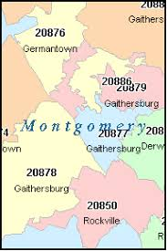

Slide 7

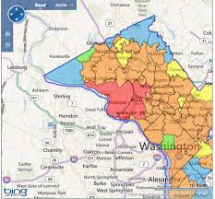

Slide 8

After analyzing the areas in the said two cities and how and where the cafes on the cities are located and how many are there, it has come to reveal that Rockville city has more cafes than Potomac city.
Further, people are tend to move to Rockville than Potomac and is a good place to live with good schools/secured neibhourhoods etc.

Slide 9

So, Finally the recommendation for Jeff Garden from the Data scientist regarding his request to seek a location for opening up his business in the State of Maryland is in 20853 and 20854 zip code area in the City of Rockville.

Slide 10
THANK YOU……….

